Slide 1


The Direct Project In A Box
http://bit.ly/direct-oscon
@healthvault
#healthvault #oscon
Ali Emami (Engineer, Microsoft)
aliemami@microsoft.com
Vaibhav Bhandari (Engineer, Microsoft)
vaibhavb@microsoft.com

Slide 2

Paper Facts
It costs nearly $250 billion to process 30 billion healthcare transactions each year
86% of mistakes made in the healthcare industry are administrative
Organizations, on average, make 19 copies of each document, spend $20 in labor to file each document and lose one of every 20 documents
Source: http://www.thepaperlessproject.com

Slide 3
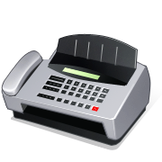
Pop Quiz
What contributes to the majority of the cost of paper communications?

Slide 4



Secure Internet-based Direct Communication
Direct Project specifies a simple, secure, scalable, standards-based way for participants to send encrypted health information directly to known, trusted recipients over the Internet.
vaibhav@direct.healthvault.com
b.wells@direct.aclinic.org
h.elthie@direct.ahospital.org
Simple. Connects healthcare stakeholders through universal addressing using simple push of information.
Secure. Users can easily verify messages are complete and not tampered with in travel.
Scalable. Enables Internet scale with no need for central network authority or multiple implementations.
Standards-based. Built on common Internet standards for secure e-mail communication.

Slide 5



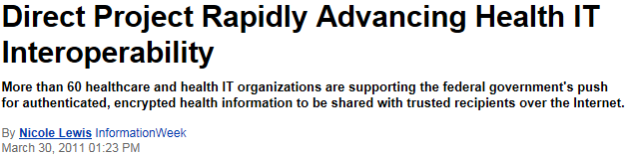

Slide 6
Direct Project Real-world Implementation
Direct Project is being demonstrated in real-world pilots across the country
Rhode Island Quality Institute (RI)
VisionShare (MN)
MedAllies (NY)
Redwood MedNet (CA)
Medical Professional Services (CT)
VisionShare (OK)
CareSpark (TN)
Direct Project is architected for rapid adoption by:
Thousands of hospitals
Hundreds of thousands of physicians
Millions of providers
Tens (or hundreds?) of millions of patients
Many other stakeholders in healthcare

Slide 7
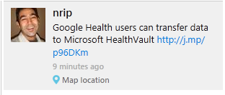

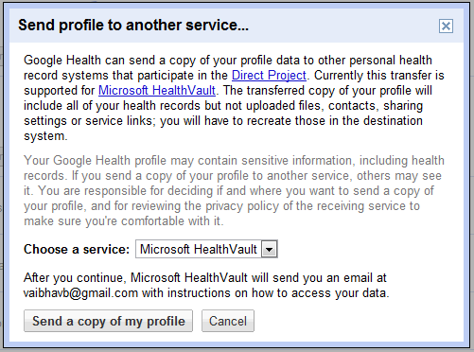
Direct In Action!

Slide 8
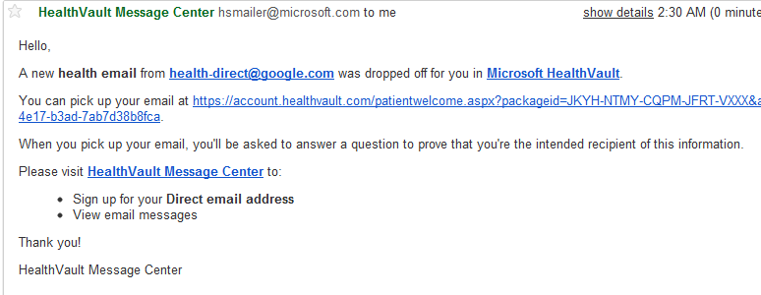
E-Mail Client

Slide 9
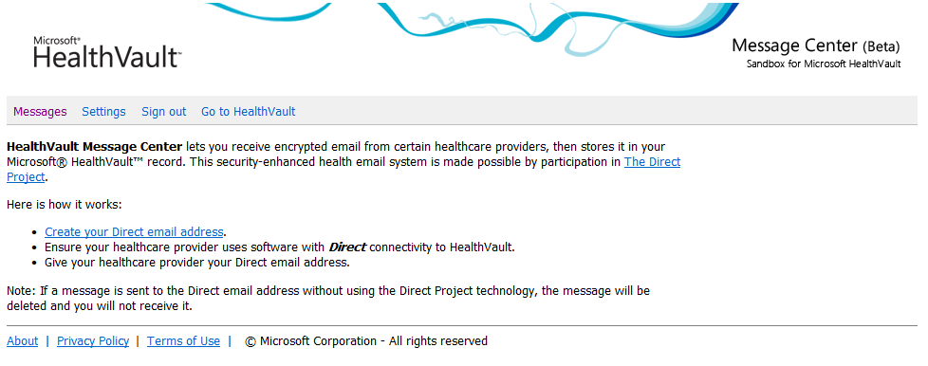
HealthVault Message Center

Slide 10
The Direct Project
High quality open source libraries
Successful open standards have easily accessible high-quality libraries trivially available to developers, including high quality documentation
A key deliverable of Direct Project is a BSD-licensed software stack enabling:
  Client-side connectivity, for EHRs, EHR Modules, PHRs, etc. and
  Server-side connectivity for “out of the box” HIOs and Health Information Service Providers (HISPs)
The history of the Internet shows the power of permissively licensed open source in driving standardization:
  TCP/IP: Berkeley TCP/IP stack
  DNS: BIND
  HTTP: Apache

Slide 11
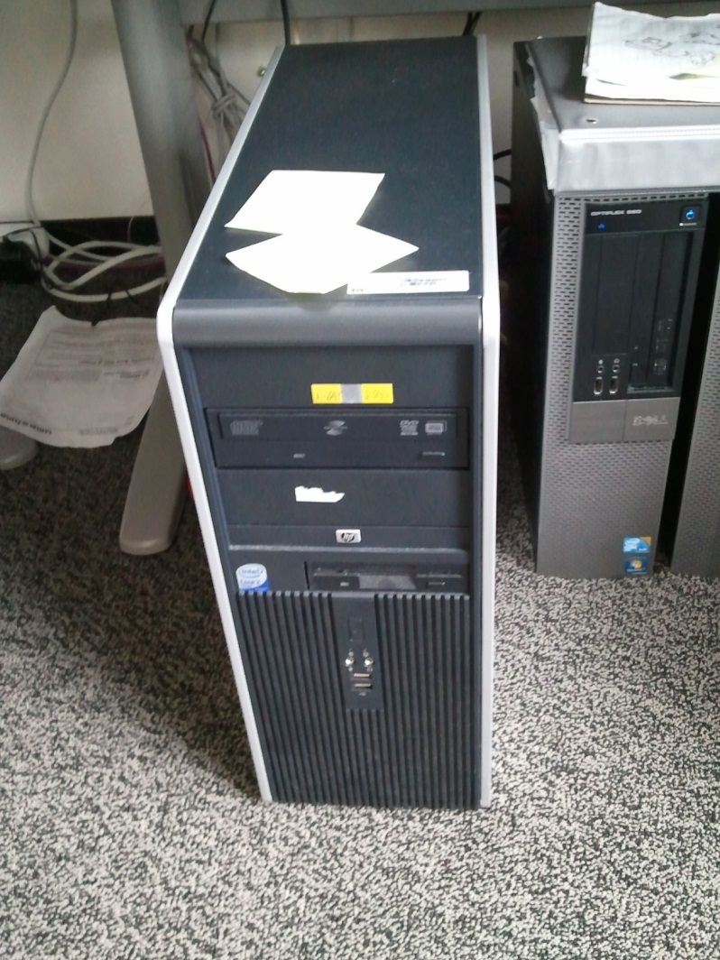
The Direct Project In A Box
The first box to send a direct message on the internet!

Slide 12
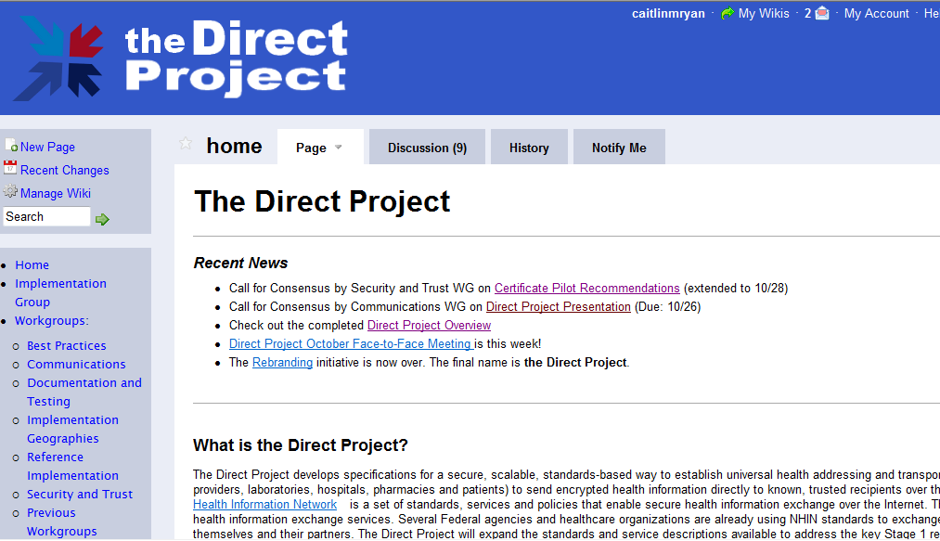
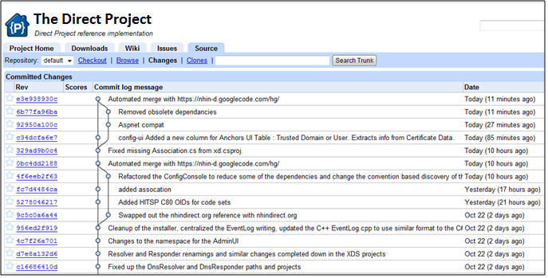
Recipe for success
Direct standards and specifications are developed by a group of public-private stakeholders. Weekly teleconferences and periodic face-to-face meetings facilitate active collaboration.
Direct Project Output:
Standards and Service Definitions
Implementation Guides
Reference Implementation
Pilot project testing and real-world implementation
Vendors incorporate reference implementation into HIT products
Wide-scale adoption of Direct standards by late 2012
First phase grounded in real-world pilot projects implemented by early 2011
Incorporation of HITPC, HITSC, and ONC policy guidance

Slide 13
Protocols and Technology
SMTP Gateway
  Direct uses SMTP as its transport protocol.
S/MIME
  Messages are signed and encrypted using the S/MIME standard.
  A decades old protocol for ensuring authenticity, non-tampering, confidentiality, delivery only to intended recipients.
DNS
  Used to serve up certificates bound to an e-mail address or organization.
  The highest scale distributed directory on the planet. Powers internet addressing.
Configuration Web Service and DB
  Storage and access to org’s certs, private keys, trust anchors
Notes:
All are available via Reference implementation.

Slide 14
HISP
Internet
Email Server
SMTP Gateway
Security & Trust Agent
MIME
+ TLS
XD* Agent
Firewall
SOAP Client
XD* SOAP Endpoint
HTTP
Gateway
Configuration
Web Service
SQL
HTML/HTTP
Admin
Configuration Web UI
DNS Server
DNS
Gateway

Slide 15
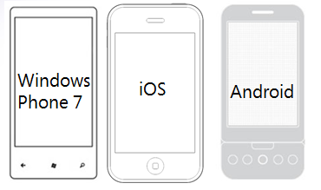

HealthVault References
Community Promise
Open Source SDKs
  Java
  Objective C
  .NET (WP7)
  Ruby
  Python
  PHP
Reference License .NET SDK
  http://www.msdn.com/healthvault

Slide 16
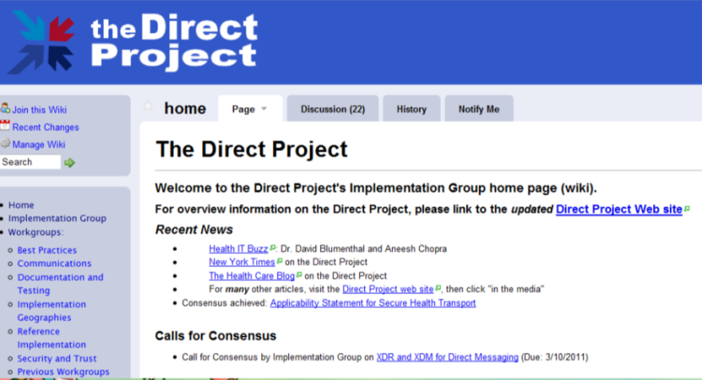
Momentum is Remarkable
MedPlus Care360
Visit summaries to patients (MU stage 1 certification)
Ability (VisionShare)
  Immunization records to patients
Beth Israel Deaconess MC
  “Zero to production” in fourteen days!
For more information email
hvbd@microsoft.com
…or just get your own address
http://healthvault.com/messagecenter
The Direct Project In A Box
http://bit.ly/direct-oscon
@healthvault, #oscon
aliemami@microsoft.com
vaibhavb@microsoft.com
Get involved!
http://wiki.directproject.org
http://msdn.com/healthvault

